Slide 1

Database Monitoring
THE ROLLING SCOPES SCHOOL
Anirban Sinha
Senior Software Development Engineer

Slide 2

Recap: What are Databases
A database is a collection of organized information for easy access and management.
Computer databases generally consist of aggregated data or files that contain information about customers, transactions, or inventories.
Regular monitoring of the database’s performance is necessary to ensure that it is running properly and to detect issues as they arise.

Slide 3

What is Database Monitoring
Database monitoring is the act of measuring a database’s performance in real time to identify problems and any other factors that can cause a problem in future. It helps understand the areas in the database that can be optimized or enhanced to improve efficiency and performance.
This is generally done with monitoring software tools that are either inbuilt with the database or installed separately from third-party vendors. Through these tools and interfaces, database administrators can monitor the performance of different database areas that serve various applications. They allow to see the performance of an application’s database through a specialized web interface.

Slide 4

Database Monitoring Metrics
Infrastructure
Availability
Throughput
Performance
Scheduled Tasks
Security
Logs

Slide 5
Lesson 1: Infrastructure
Infrastructure-related database monitoring metrics include:
Memory available
Percentage of CPU time that is used by database processes
Available disk space
Percent virtual memory use
Disk queue for waiting I/O

Slide 6
Lesson 2: Availability
Before you can look at other counters, you should ensure that your database is accessible and available. It also saves you from the trouble of complaining customers before finding out an outage. Availability metrics include:
Accessibility of database end point and port (e.g. 5432 for PostgreSQL, 3306 for MySQL, etc.)
Accessibility of database node(s) that use common protocols like Telnet or Ping
Failover event for master node or upgrade event for peer/slave nodes in clusters with multi-nodes.

Slide 7
Lesson 3: Throughput
It is measured to create a normal production performance baseline. Metrics vary according to database platforms, but there are some common metrics among all platforms such as:
Number of active database connections
Average time for completing a read query
Connection wait time for endpoints
Number of read queries in progress or received
Average time for completing an update, insert or delete command
Number of update, insert, or delete commands that are in progress or received
Number of transactions completed
Heap memory used
Replication lag between a primary and secondary node
Data growth and transaction log size percent rate
Percentage of number of times in-memory data cache was accessed

Slide 8
Lesson 4: Performance
Performance metrics also vary according to different databases and have to be reported in a particular time-scale. They indicate any potential bottlenecks and it is recommended to create baselines for them.
Common performance metrics include:
Number of database lock timeouts
Number of read or write queries that are blocked or currently waiting
Number of deadlocks
Percentage of times the disk-based virtual memory is accessed
Application traces
Skewed data distribution in the nodes
Warnings for unusable indexes or outdated statistics
Queries that run slower than a certain threshold

Slide 9
Lesson 5: Scheduled Tasks
These are repetitive tasks in a database. Some systems such as Oracle or Microsoft SQL Server have inbuilt job scheduling options, whereas other use cron jobs or third-party schedulers. Some scheduled jobs to monitor include:
Database maintenance tasks such as
vacuuming
analyzing and updating statistics
Reindexing
log rotation
database integrity checks
compaction, etc.
Application-specific tasks such as archiving and data exportation, etc.
Regardless of the type of job, the outcome of a scheduled task has to be monitored in terms of success or failure.

Slide 10
Lesson 6: Security
Database security needs to be monitored in accordance with enterprise security goals. As a bare minimum, it is important to monitor the following:
Database maintenance tasks such as
vacuuming
analyzing and updating statistics
Reindexing
log rotation
database integrity checks
compaction, etc.
Application-specific tasks such as archiving and data exportation, etc.

Slide 11
Lesson 7: Logs
All database engines have some types of logs where they record the information. Logs can consist of one or more files. Database monitoring services should collect, parse and store logs to create metrics from the events that are exposed as a result. Logs can consist of valuable information such as
User and system queries
Outputs of scheduled jobs
Database system events such as errors, startup, shutdown, etc.

Slide 12
DB Monitoring Tools
Effective database monitoring tools are those that can capture, store and analyze the events and metrics and create meaningful results from it. When choosing your database tools, there are different options to consider.
Some of the database software is included as a value-added product with monitoring tool
Some database services have their own monitoring tools such as, Oracle Enterprise Manger
Open-source databases that are commercially distributed can have monitoring tools as well.
Some database administrators use their own tasks and scripts to capture the metrics and build personalized dashboards.
Enterprise Application Performance Monitoring tools such as the one by VirtualMetric, also provide database plugins.

Slide 13
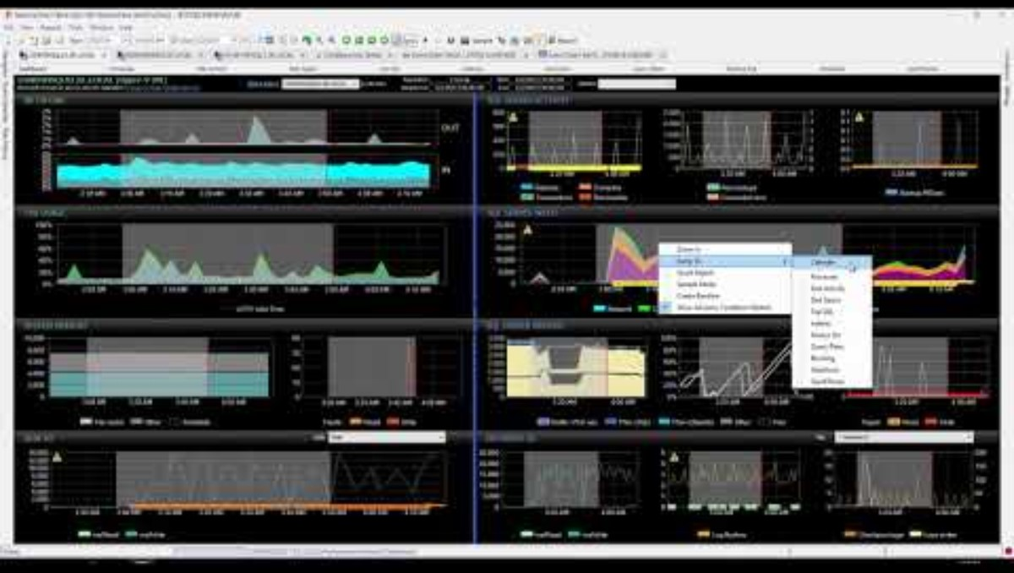
Real monitoring System - Sentry

Slide 14

Quiz
What is an essential component of database infrastructure monitoring?
a) Server power consumption
b) Hardware compatibility
c) Backup frequency
d) Database schema design

Slide 15

Quiz
2. What does "High Availability" refer to in database monitoring?
a) The ability of a database to be always accessible and operational
b) The amount of data stored in a database
c) The number of concurrent users
d) The speed at which queries are executed

Slide 16
Quiz
3. Which metric measures the amount of data processed by a database in a given time frame?
a) Latency
b) Throughput
c) Uptime
d) Query complexity

Slide 17
Quiz
4. What is a common way to assess database performance?
a) The number of scheduled tasks
b) The size of the database server
c) Response time to user queries
d) Number of security patches applied

Slide 18
Quiz
5. Which of the following is NOT a typical example of a scheduled task in database management?
a) Data backups
b) Index rebuilds
c) User login events
d) Data archiving

Slide 19
Quiz
6. What is the primary goal of database security monitoring?
a) Ensuring that the database is always running
b) Protecting data from unauthorized access and breaches
c) Maximizing database throughput
d) Regularly updating database software

Slide 20
Quiz
7. Which of the following is NOT a common type of database log?
a) Error logs
b) Transaction logs
c) Access logs
d) Backup logs

Slide 21
Quiz
8. Why are database logs important in the context of monitoring?
a) They help with server maintenance
b) They provide insights into database performance and security incidents
c) They are used to schedule routine tasks
d) They display the server's hardware status

Slide 22
Answers
1. b) Hardware compatibility
2. a) The ability of a database to be always accessible and operational
3. b) Throughput
4. c) Response time to user queries
5. c) User login events
6. b) Protecting data from unauthorized access and breaches
7. d) Backup logs
8. b) They provide insights into database performance and security incidents

Slide 23

Thank you
Anirban Sinha
Senior Software Engineer
EPAM Systems
reach@anirbansinha.in
www.anirbansinha.in

